Slide 1


DCC institutional engagements
Reflections on building capacity and capability for research data services
Graham Pryor, Associate Director
Digital Curation Centre
Institutional repositories and data - roles and responsibilities
OR2012 workshop, 9th July 2012

Slide 2
Repositories have made significant inroads in terms of impact and use despite, in the case of institutional repositories, the very limited resources deployed. Subject repositories, like arXiv and PubMed Central, have certainly come of age but institutional repositories probably have not come of age yet although there are drivers in place which, in theory anyway, are moving them towards early adulthood.
Digital repositories ten years on: what do scientific researchers think of them and how do they use them? David Nicholas et al, Learned Publishing, 25: 195–206; doi:10.1087/20120306

Slide 3
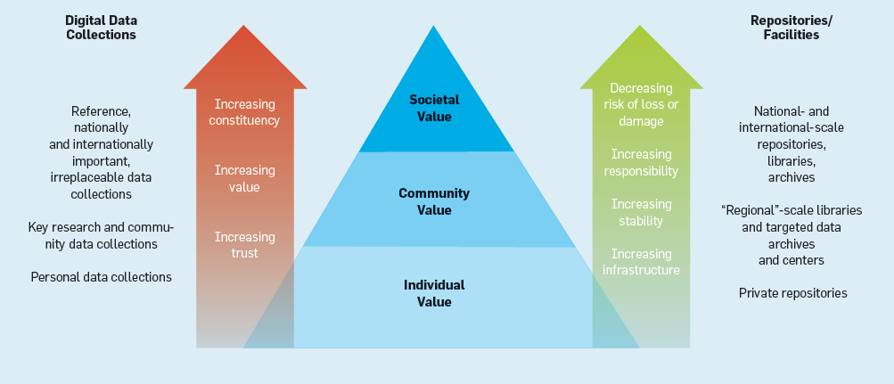
The Data Pyramid – a hierarchy of rising value and permanence
From Got Data? A Guide to Data Preservation in the Information Age, Francine Berman, ACM, 2008

Slide 4
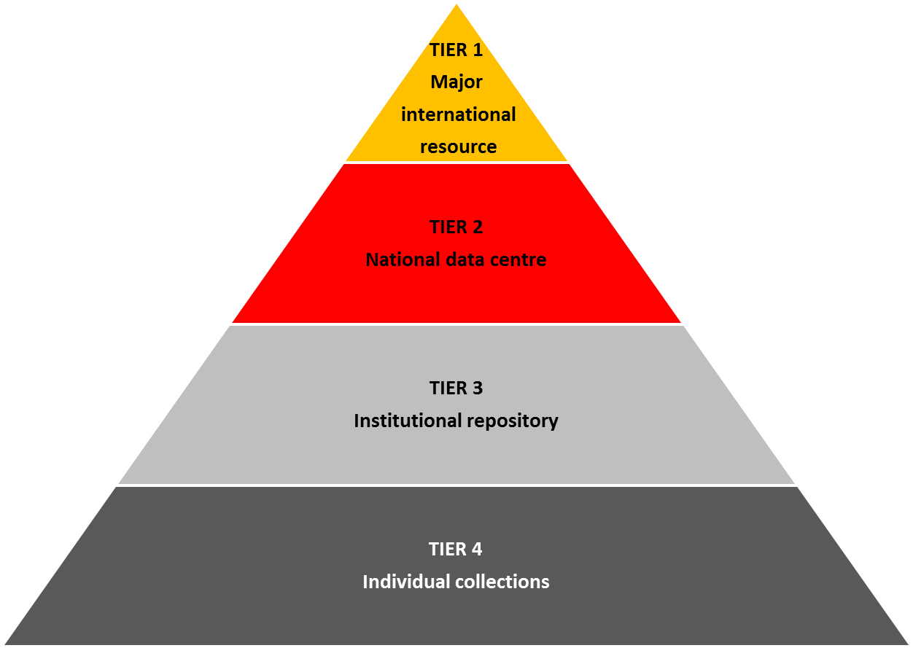
The Data Pyramid – a hierarchy of rising value and permanence
Dryad? Acting as repository for data made accessible under journal data policy.
Large Hadron Collider, Worldwide Protein Data Bank, etc.
Breadth of the value of data increases up the tiers: from individual to community to social value.
Each higher tier brings greater social responsibility and demands for access.
As infrastructure increases, so must the attention to standards, sustainability and provenance.
Use of off-the-shelf tools lacking curation functionality. Increasing trend towards portal services like Figshare.
Redrawn from, Science as an Open Enterprise, Royal Society, 2012

Slide 5

Structured data repositories and databases: 5
- national platforms, genetics bias (e.g. Genbank)
Domain specific and general data repositories: 146
- specialised national/international data vaults
- publicly funded national data centres serving specific domains (NERC, UKDA, etc.)
- includes 42 World Data Centres (Geology, Space Science, etc.) with limited online open access
- only 1 is a university research data service (Edinburgh’s DataShare)
http://datacite.org/repolist at 26 June 2012

Slide 6
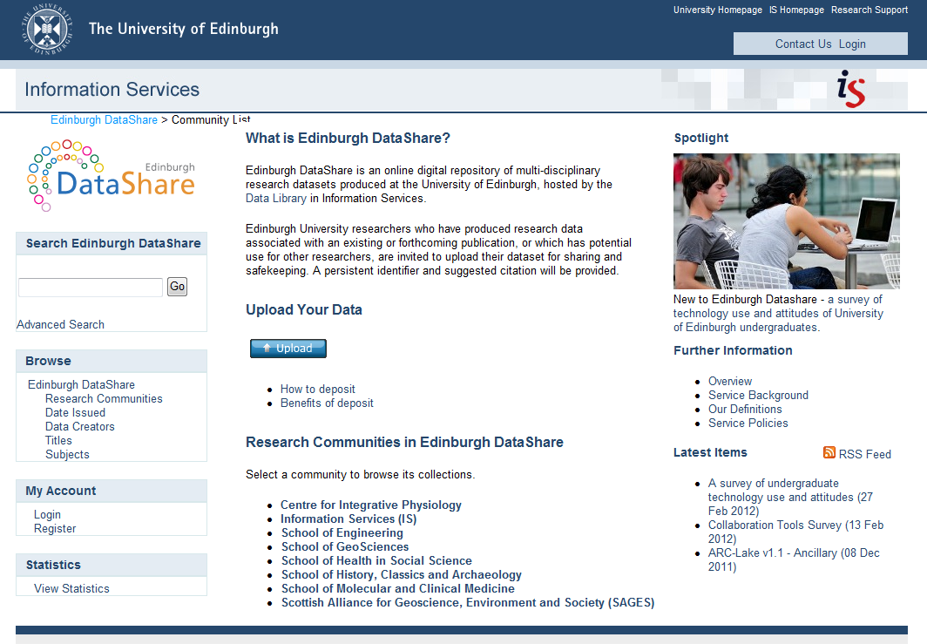
Contains 18 datasets

Slide 7
Three questions for you
What responsibility should academic institutions have for supporting the data curation needs of their researchers?
What responsibilities should academic institutions have for curating the data they produce?
Should academic institutions engage with these questions only where there is no tier 1 or tier 2 service available?

Slide 8
DCC institutional engagements
http://www.dcc.ac.uk/community/institutional-engagements
Socio-technical management perspectives
Information systems perspectives
Research practice perspectives
2. Diagnose practices
Inventory data assets
Profile norms, roles, values
Identify infrastructure capacities
Analyse current workflows
1. Initiate change
Identify drivers and champions
Analyse perceived issues/challenges
Identify capability gaps
Assess costs, benefits, risks
3. Redesign research data services
Produce feasible, desirable changes
Evaluate fitness for purpose
Adapted from Developing Research Data Management Capabilities by Whyte et al, DCC, 2012

Slide 9
Institutional engagements – typical activity
Institutional
data catalogues
Assess needs
Workflow assessment
Pilot RDM tools
DCC support team
Develop support and services
DAF & CARDIO assessments
Guidance and training
RDM policy development
Advocacy with senior management
Customised Data Management Plans
Make the case
…and support policy implementation
Notes:
We’ll talk more about some of these shortly, but first we’ll give a snapshot of the current UK ‘scene’…

Slide 10
IE roles and responsibilities
50% of the engagements have senior academic champions
Team leaders
Library – 11
Research office – 7
IT services – 2
Major support
Library – 7
Research office – 2
IT services – 6
Records management – 2
Repository management – 1

Slide 11

Principal foci of IEs
Use of DCC tools (Data Asset Framework, CARDIO, DMP Online)
Roadmap design (EPSRC)
Training in skills and techniques for support staff
Policy development
Policy implementation
12
7
4
4
2

Slide 12
A rationale for institutional data repositories? The view from 15 out of 20 DCC institutional engagements
 | Yes | No | Qualified
Do you have/anticipate having an institutional repository? | 15 |  | All but two have only document IRs at present
Do you expect to use it to store and manage research data? | 8 | 3 | 3 – maybe/probably 1 – but not Big Data
Do you expect to rely on data repository services operating at a national or international level where these exist? | 15 |  | But within a mixed economy; using persistent URLs to reference them
Would these be seen as an alternative to institutional services? | 11 | 4 | Complementary to IRs; wary of using only international
Will you be developing a research data catalogue that tracks your data wherever it is deposited? | 11 |  | 3 – maybe (and subject to funding) 1 - aspirational

Slide 13
Top challenges for the data repository champion
FUNDING
Cost and cost recovery, particularly longer term – how much and who pays?
How to ensure long term maintenance, sustainability and use
BUY-IN
Achieving academic staff/researcher engagement and high deposit rates
Making the case and encouraging uptake through awareness raising
Getting researchers to think about data management early enough in the lifecycle to make future management simpler
SOCIO-TECHNICAL ISSUES
Lowering the barriers to deposit
Managing the reality that ‘one size will not fit all types of data’
Providing user interaction beyond the ‘download a file’ model that repositories typically offer
Addressing the subject-specific nature of data and the potential for re-use by other disciplines
Having an effective, up-to-date catalogue of all data in all repositories used
Understanding the layers of metadata required to describe diverse datasets
Recruiting a data specialist to take forward the library’s role in data support
Predicting the scale of data requirements, capacity planning

Slide 14
Why build institutional data repositories?
Why stress over resolving the challenges reported here?
Why struggle to secure and invest scarce resources in training, restructuring and depreciating capital infrastructure?
Why not use alternative services (some already exist, e.g. national data centres and international repositories)?
Why not seek to attract and exploit new entrants (e.g. specialised commercial services, emerging cloud services and the publishing community)?
Why not focus on building institutional data catalogues?
Human beings are the only creatures on Earth that pose the question ‘why?’. The floor is yours…

Slide 15
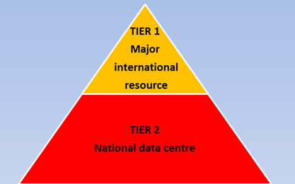
Those initial three questions again
What responsibility should academic institutions have for supporting the data curation needs of their researchers?
What responsibilities should academic institutions have for curating the data they produce?
Should academic institutions only engage with these questions where there is no tier 1 or tier 2 service available?

Slide 16

http://www.dcc.ac.uk/community/institutional-engagements

